Slide 1

Department of Computer Science and Engineering
Music Genre Classification using ML Algorithms
Date: 27 May 2021
B. CHARITHA : 17WH1A0597​
G. ANITHA : 17WH1A0586
K. ANJALI : 18WH5A0514
Internal Guide: Ms. G. SHANTI​
Designation: Assistant Professor

Slide 2

Abstract
Why Should I Study this course?
Music genre classification is used to classify the audio files to a particular category for example, blues, classical, country, hip hop, rock, disco, etc. Categorizing music files according to their genre is a challenging task and cannot be done manually. This project automates the classification of audio files by extracting the spectral features, classifying the audio file based on the extracted features. Classification methods like K Nearest Neighbours, Naïve Bayes, Decision Tree, Random Forest, Support Vector Machine were employed. Furthermore, Convolutional Neural Network-CNN is also used to classify genres, where spectrograms of audio files are fed to CNN to obtain the feature vector.
Examples
BVRIT HYDERABAD College of Engineering for Women

Slide 3
Architecture
Why Should I Study this course?
Extracting spectral features from audio files
classification models
(KNN, SVM, Naive Bayes, Random Forest, Decision Tree)
Evaluation
Examples
BVRIT HYDERABAD College of Engineering for Women

Slide 4
Feature Extraction
Spectral features are extracted by converting time based signal into frequency domain.
Features extracted are :
zero crossing rate
Spectral centroid
Spectral roll off
Spectral contrast
Spectral bandwidth
Mel Frequency Cepstral coefficients

Slide 5
Architecture for CNN
Why Should I Study this course?
Generating spectrogram for each audio file
Feeding spectrograms to CNN
Dense layer feature vector
Examples
BVRIT HYDERABAD College of Engineering for Women

Slide 6
CNN
Applying Short term Fourier transform to the audio file
Generating spectrograms for the audio files
Feeding spectrograms to CNN
Generating feature vector which is used to classify audio file

Slide 7
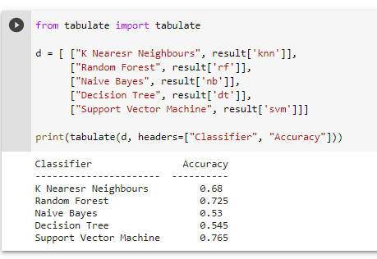
Output

Slide 8
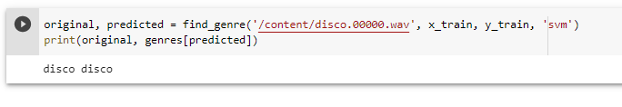
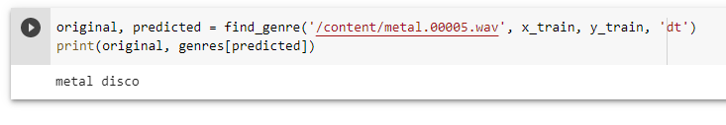
Output

Slide 9
Thank you

